Slide 1
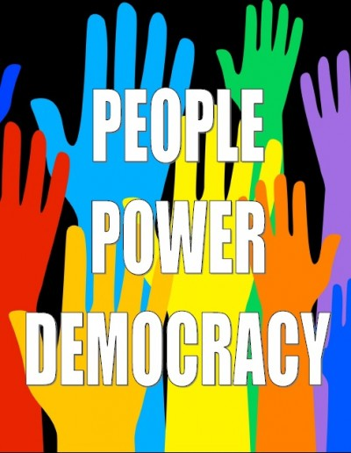
Civics and Citizenship
6 Key Concepts

Slide 2
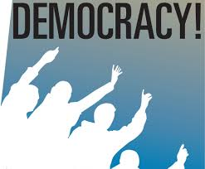
six Key Concepts Civics and Citizenship
Westminster System
Democracy
Democratic Values
Justice
Participation
Rights and Responsibilities

Slide 3
Westminster system
A democratic system of government modelled from the United Kingdom (Palace of Westminster seat of British Parliament).
Features of the Westminster system:
Executive branch – made up of members of the legislature
Opposition parties
Bicameral or Unicameral legislature
Ceremonial head of state, different from the head of government and who may possess powers which are symbolic and not normally exercised

Slide 4
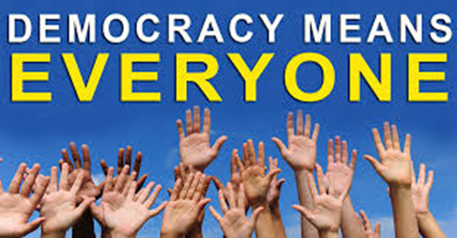
democracy
The concept of democracy is about the acceptance of the will of the majority combined with the rule of law and particular freedoms.
Decision making within the local and wider community and the ideas of sovereignty and government restraint
Roles and responsibilities of the individual within society
The roles of the Commonwealth Constitution and its key elements
The political and legal institutions and their roles

Slide 5

Democratic values
The Australian democracy has at its heart, the following core values:
Freedom of election and being elected;
Freedom of assembly and political participation;
Freedom of speech, expression and religious belief;
Rule of law;
Human rights.

Slide 6
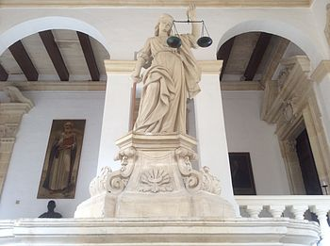
Justice
The rule of law and its application; the idea of equality before the law, the importance of judicial independence and objectivity leading to the law being perceived as fair.
The processes of the courts and parliaments in Australia and the centrality of the rule of law i.e no one is above the law

Slide 7

participation
The concept of participation is about how an individual can be involved in the political and legal system as both a decision maker and as an agent of change in terms of being proactive and reactive. An understanding of the concept of participation is developed in the following ways:
The role and place of political parties, pressure groups and community groups within society
The electoral system and the conduct of elections in Australia

Slide 8

Rights and responsibilities
Rights and freedoms an individual has within Australian society as well as the obligations of citizens, especially within the political and legal system. The various ways rights are protected in Australia

Slide 9
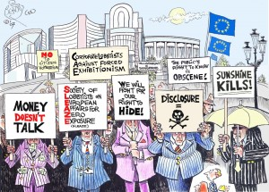
Lobby groups in Australia

Slide 10
LOBBY GROUPS ARE ALSO KNOWN AS INTEREST GROUPS AND PRESSUE GROUPS
An interest (or pressure) group is a group of people or a formal organisation that seeks to protect the interests of its members or promote a particular cause. Interest groups aim to influence a particular government policy in a particular area. They are not necessarily interested in offering candidates for parliament but in influencing government policy.

Slide 11
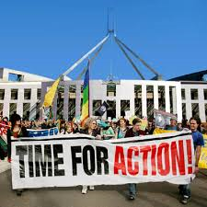
BRAINSTORM
CAN YOU THINK OF TWO GROUPS IN AUSTRALIA THAT SEEK TO CHANGE GOVERNMENT POLICY ON A CERTAIN ISSUE?
WRITE THEM DOWN

Slide 12

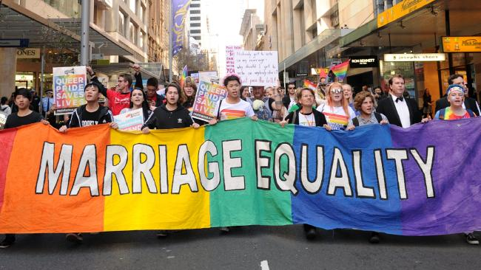


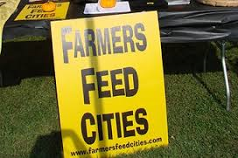

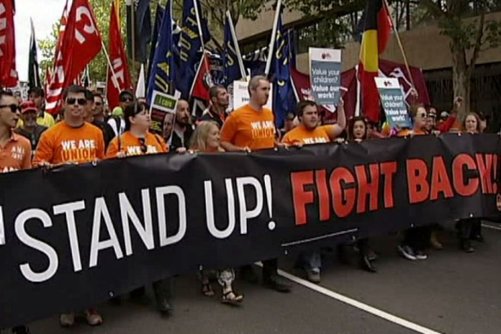

Slide 13
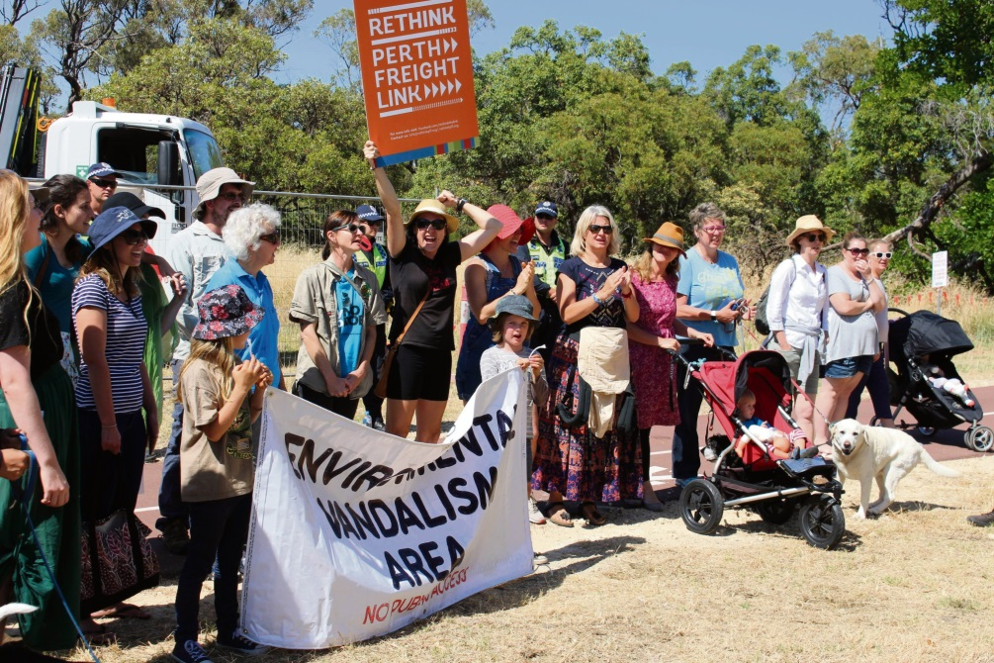
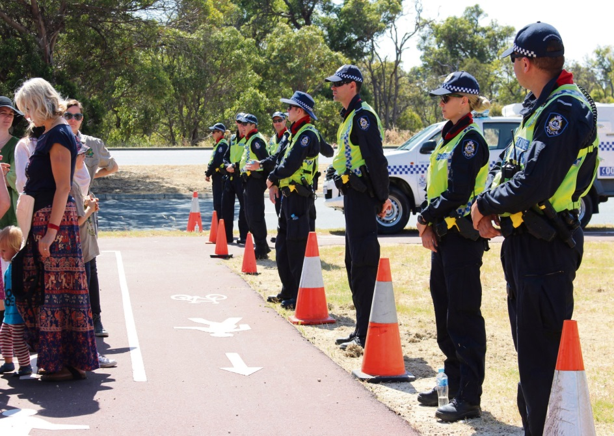
ROE 8 HIGHWAY PROTEST
SAVE BEELIER WETLANDS GROUP https://www.youtube.com/watch?v=7177rk4Q00Y&feature=youtu.be

Slide 14
Save beelier wetlands group!
https://www.youtube.com/watch?v=TZH-RXT-nDw
What is the aim of this group?
What methods do they use to get their message across?
How effective do you think they are?

